Slide 1


PREDICTING PAYPAL STOCK PRICES USING LINEAR REGRESSION
Name : Susairaj Anthony
Student ID: 22071718
Google Colab Notebook Link: https://colab.research.google.com/drive/1H72FfXszXZUC1IcIKl7aVK145lm658Ry?usp=sharing

Slide 2


Introduction about PayPal
PayPal is an online payment system that allows you to send and receive money around the world
Transaction revenues 92%
Revenues from other value-added services 8%
PAYPAL SERVICES
SIMPLE MONEY TRANSFERS
PAYPAL SHIPPING
INDIVIDUALS
MERCHANTS
DEBIT/CREDIT CARDS
INVOICING
CHECK CASHING
WORKING CAPITAL
E-CHECK SERVICES
PAYPAL LOANS

Slide 3

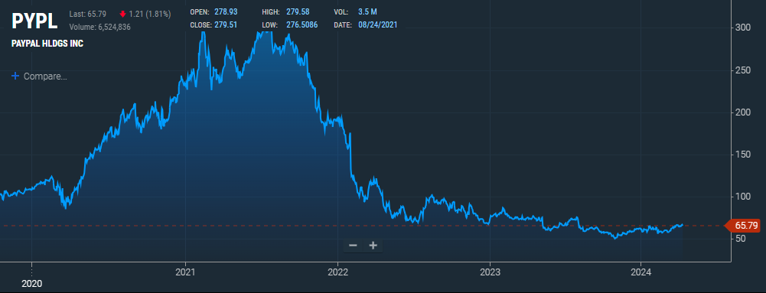
PayPal has 1.07 billion shares outstanding. The number of shares has decreased by -4.40% in one year.
PayPal has a market cap or net worth of $70.57 billion. The enterprise value is $60.12 billion.
Data collection period from January 1, 2021, to January 1, 2024
KNN, RF, MLP and LRs are trained on the training data to predict PayPal's stock prices
PayPal stock dataset Imported from yfinance
Calculation of 50-day and 200-day Simple Moving Averages (SMA
Each model is evaluated using the Root Mean Squared Error (RMSE), and the predictions are visualized
Data loading

Slide 4

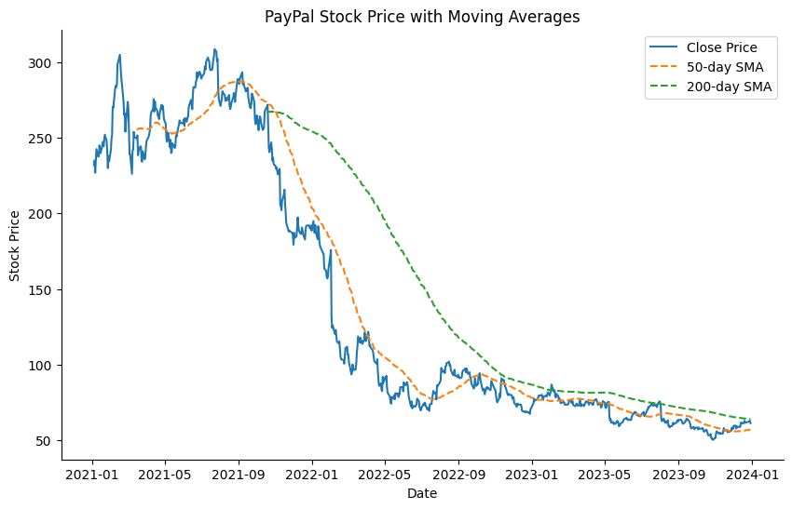
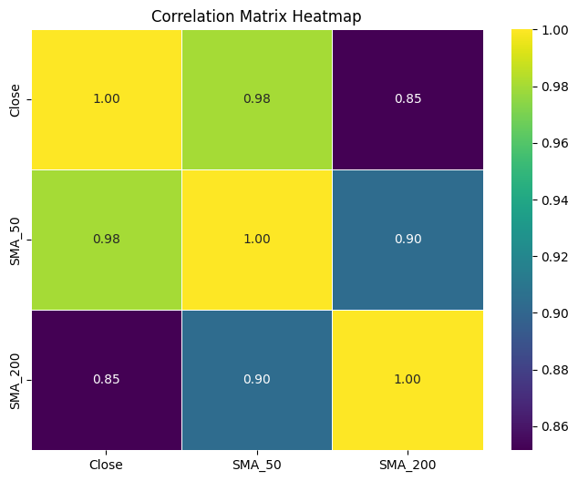
First, we apply Min-Max scaling to normalise the closing stock prices. In order to ensure that every feature has the same scale, this method converts the data into a range between 0 and 1. It enhances some algorithms' performance and aids in stabilising the training process.
Technical analysis indicators called moving averages take the average price over a predetermined period of days to smooth out price data. It is believed that the 200-day SMA is a long-term moving average, and the 50-day SMA is a short-term moving average.
A positive correlation between the closing price and a moving average suggests that as the moving average increases, the closing price tends to increase as well
A negative correlation would imply that as one variable increases, the other tends to decrease
The heatmap visualization provides a quick way to identify correlations visually. Strong correlations (positive or negative) are represented by brighter colors (closer to yellow or dark blue), while weaker correlations are represented by duller colors (closer to green)
Preprocessing

Slide 5
K-Nearest Neighbors (KNN):
Parameters Used for Each Model
KNN: Number of neighbors (k): 5
Random Forest:
Number of trees: 100 and Random state: 42
MLP: Hidden layer sizes: (100, 50)
Maximum iterations: 500 Random state: 42
Model
KNN is a straightforward and powerful algorithm for regression tasks. It predicts by averaging the target values of the 'k' closest neighbors in the feature space. The prediction relies on how similar the input
data points are to the training data
01
Random Forest:
Model
Random Forest is a powerful ensemble learning method. It builds many decision trees during training and predicts by averaging their individual predictions. Known for its robustness to overfitting, Random Forest excels with high-dimensional data.
02
Time Series Data structure: A 30-day look-back period is included in the time series data format. This indicates that the stock prices over the last 30 days are taken into account while creating each data point in the training and testing sequences.
Model Definition
Multilayer Perceptron's (MLP):
Model
MLP is a type of neural network. It has multiple layers of interconnected nodes (neurons), where each layer is fully connected to the next. MLP is adept at approximating complex nonlinear functions and is commonly used in regression tasks.
03
Linear Regression
Model
Linear Regression is a method to find the straight line that best fits a set of data points, representing the relationship between independent and dependent variables. It's commonly used for predicting outcomes based on historical data and understanding the linear relationship between variables.
04

Slide 6
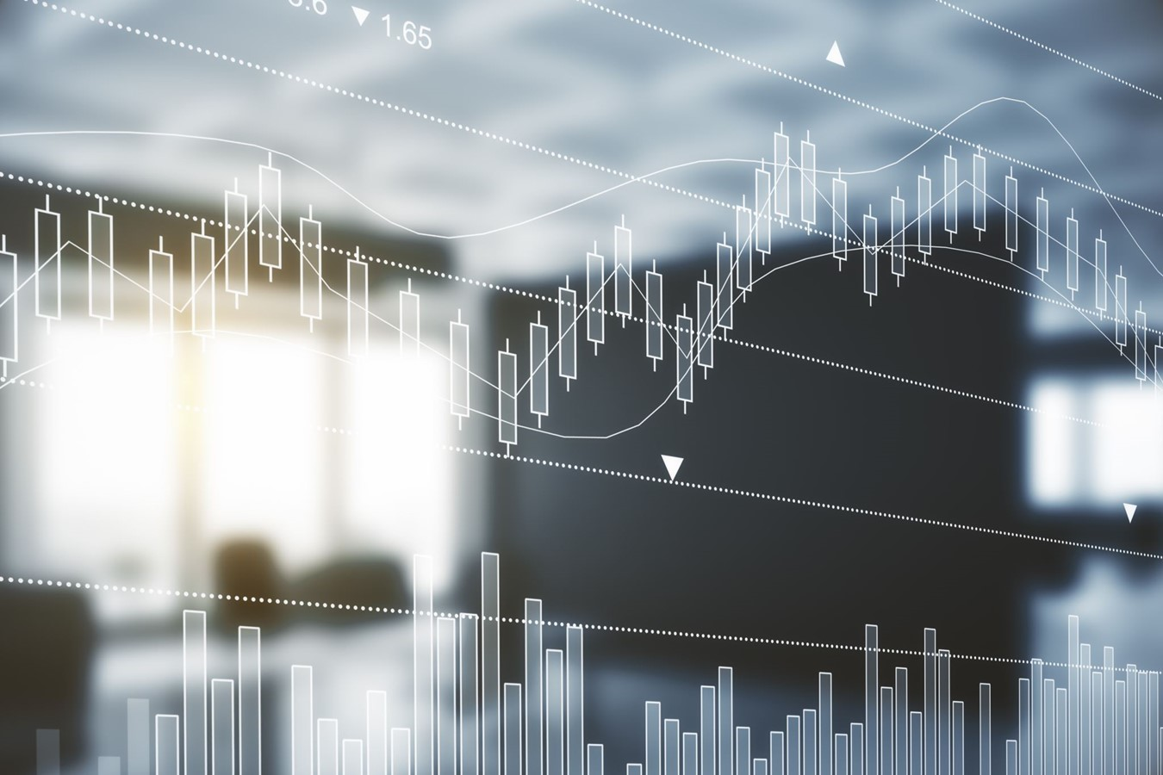
Training and Testing
Dataset Splitting:
The dataset is divided into training and testing sets, with 80% of the data allocated for training and 20% for testing.
Training Process Overview:
K-Nearest Neighbors (KNN) Model:
The KNN regression model is trained using the training sequences.
The n_neighbors parameter is set to 5.
Random Forest Model:
The Random Forest regression model is trained using the training sequences. 100 decision trees are used (n_estimators=100)
Multilayer Perceptrons (MLPs) Model:
The MLP regression model is trained using the training sequences. The architecture consists of two hidden layers with 100 and 50 neurons respectively (hidden_layer_sizes=(100, 50)). The maximum number of iterations is set to 500 (max_iter=500)
Generation of Training and Testing Sequences:
For creating sequences of data suitable for training the models, a look-back period of one month (30 days) is chosen.
Training sequences are generated by iterating over the training data, where each sequence consists of the previous 30 days' closing prices, and the target is the next day's closing price.
Similarly, testing sequences are generated from the testing data following the same look-back period.

Slide 7

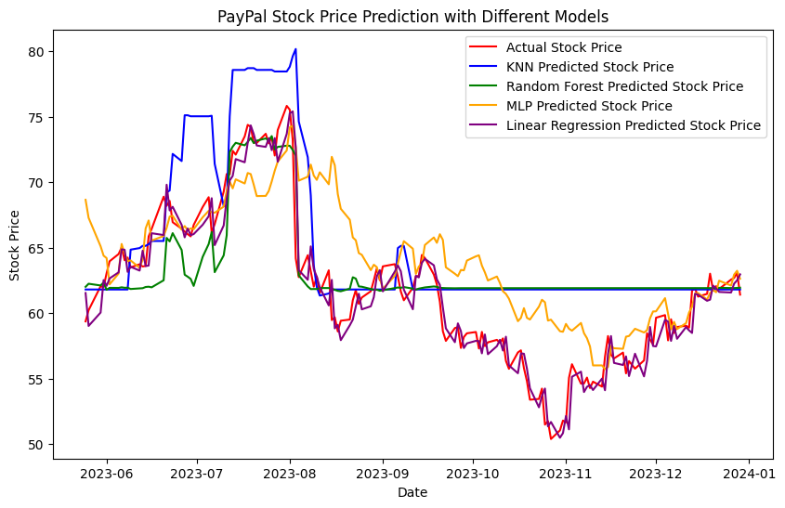
Model Performance
Comparison of Model Performance:
KNN Predictions (Blue):
RMSE: 0.019
Provides predictions based on similarity to neighboring data points.
Captures trends and patterns but may struggle with complex
relationships.
Random Forest Predictions (Green):
RMSE: 0.016
Utilizes an ensemble of decision trees for predictions.
Offers robustness and handles non-linear relationships well.
MLP Predictions (Orange):
RMSE: 0.016
Employs a multilayer perceptron neural network for forecasting.
Effective in capturing complex patterns but may require careful tuning.
Linear Regression Predictions (Purple):
RMSE: 0.006
Utilizes a linear relationship between features and target.
Provides simple and interpretable predictions but may oversimplify complex data.

Slide 8

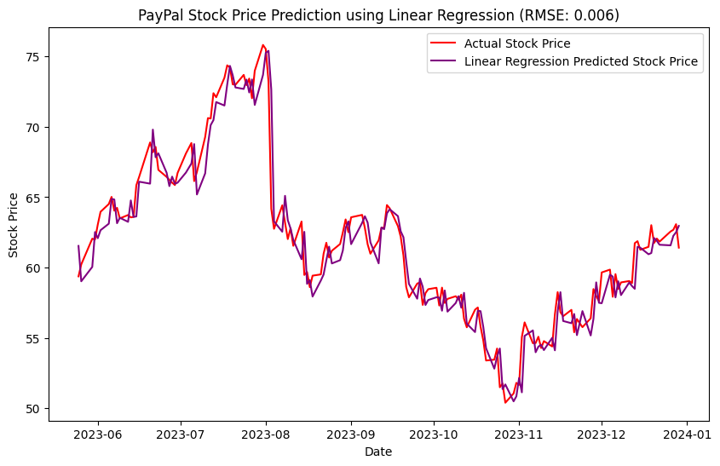
Predictions vs. Actual Data
Root Mean Squared Error (RMSE) Values:
KNN RMSE: 0.019
Random Forest RMSE: 0.016
MLP RMSE: 0.016
Linear Regression RMSE = 0.006
The Best Model Linear Regression :
The RMSE values provide an indication of the accuracy of each model in predicting the PayPal stock prices.
Lower RMSE values indicate better predictive performance.
Linear Regression model achieved the lowest RMSE of 0.006, indicating better performance compared to the all-other models with an RMSE of 0.016 (RF& MLP) and 0.019 (KNN).
The best model, with an RMSE of 0.006, is linear regression.

Slide 9


Model Evaluation
Linear Regression:
Strengths:
Simple and interpretable model based on linear relationships. Quick training and inference times.
Weaknesses:
Limited in capturing complex non-linear relationships. Susceptible to outliers and noise.
Reliability:
Identified as the best model for PayPal stock price prediction due to its simplicity and interpretability.

Slide 10

Conclusion and Future Work
Limitations and Potential Areas of Improvement:
Limited Feature Set: The models utilized a limited set of features, primarily historical stock prices and simple moving averages. Incorporating additional relevant features such as trading volume, external market indicators, or sentiment analysis from news sources could enhance model performance.
Data Quality: While efforts were made to clean and preprocess the data, inconsistencies or missing values could still affect model accuracy. Continuous monitoring and refinement of data preprocessing techniques are necessary to ensure model robustness.
Model Complexity: The models employed in this project had relatively simple architectures. Exploring more complex models, such as Long Short-Term Memory (LSTM) networks for capturing sequential dependencies in the data, could potentially improve prediction accuracy, especially in capturing non-linear relationships.
Future Directions for Enhancement:
Ensemble Methods: Combining the predictions of multiple models through ensemble methods like stacking or blending could potentially yield more robust and accurate predictions by leveraging the strengths of individual models.
Hyperparameter Tuning: Fine-tuning model hyperparameters using techniques like grid search or Bayesian optimization could optimize model performance further.
Feature Engineering: Continuously exploring and incorporating new features derived from domain knowledge or external sources could provide additional signals for the models to learn from, potentially improving predictive accuracy
Advanced Techniques: Exploring advanced techniques such as reinforcement learning for dynamic portfolio optimization or incorporating deep learning approaches tailored for financial time series analysis could be avenues for future research to enhance prediction models in the financial domain.

Slide 11

References
Stock Analysis Dataset: The link directs to the Yahoo Finance page for PayPal's stock (PYPL), which is the correct source for retrieving stock data. https://finance.yahoo.com/quote/PYPL/
About Company (PayPal Holdings, Inc.): https://www.paypal.com/uk/webapps/mpp/about
How PayPal Makes Money: https://www.investopedia.com/how-paypal-makes-money-5094794 By MATTHEW JOHNSTON Reviewed by CHARLES POTTERS Updated December 31, 2022
uk.finance.yahoo.com. (n.d.). Top most active stocks list | Screener – Yahoo Finance. [online] Available at: https://uk.finance.yahoo.com/most-active/ This website could be relevant for gathering financial information and market data.
Model explanation and ideology: : Machine learning algorithms: An explainer - University of Wolverhampton (wlv.ac.uk) by Ben Nancholas Posted on: December 19, 2023

